Slide 1
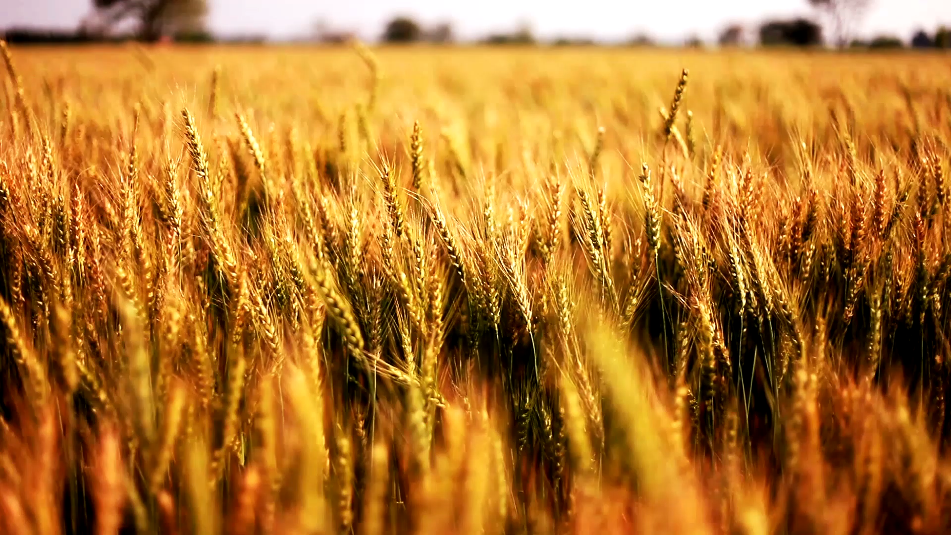
Brewing Data Final Analysis
Featuring:
Danne Paredes
Prateetya Bajracharya
Seth Abbott

Slide 2
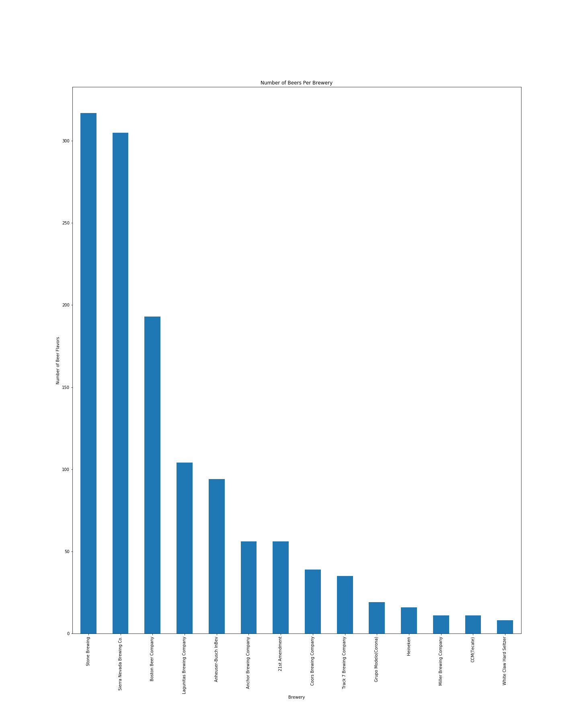
Number of beer varietals per brewery

Slide 3
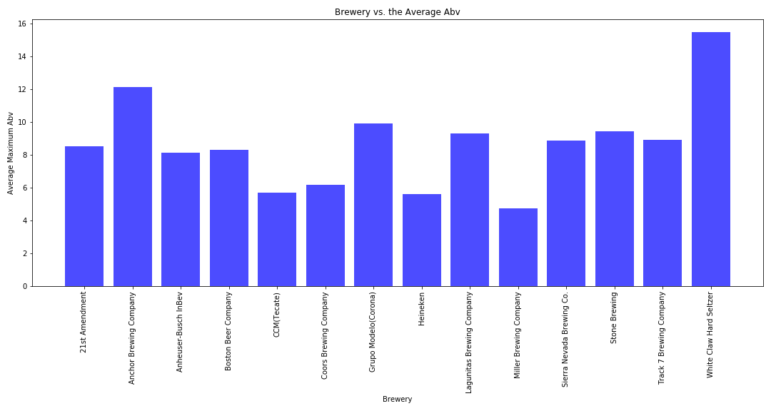
Average Maximum abv per Brewery

Slide 4
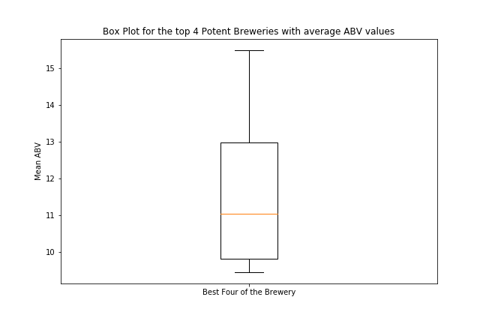
Distribution of Max ibu values per brewery

Slide 5
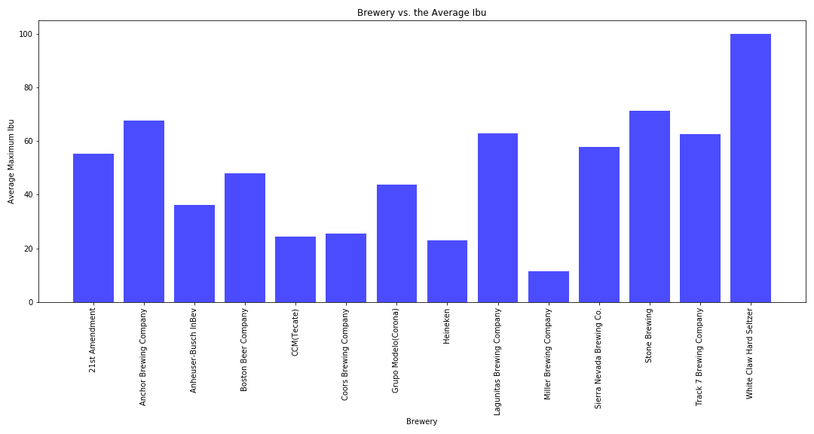
Average Maximum ibu per Brewery

Slide 6
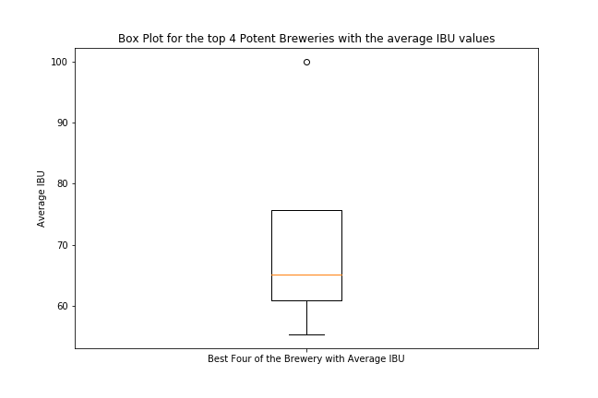
Distribution of Max ibu values per brewery

Slide 7
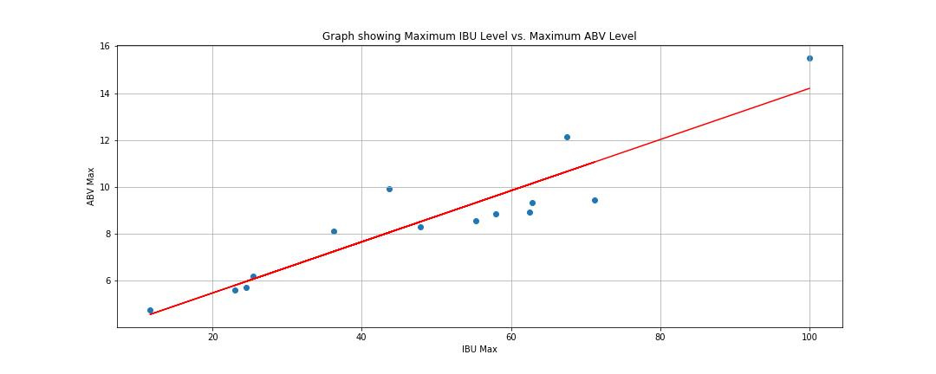
Max abv vs. Max Ibu: strong Positive correlation

Slide 8
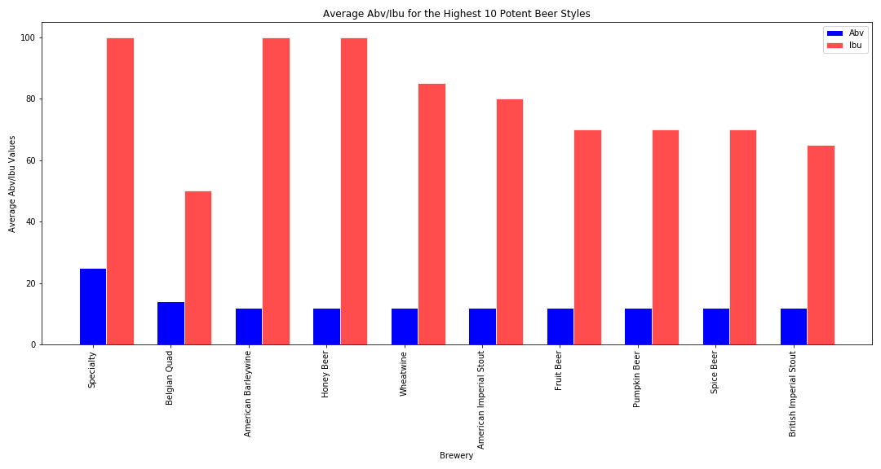
Most Potent styles of beers: Abv and abu averages

Slide 9
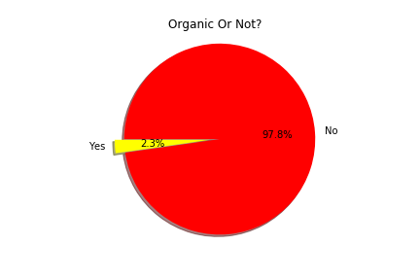
Percentage of beers that are organic

Slide 10

Special tribute to our fallen teammate: Angel e. moreno 3/31/20 – 5/18/20 Gone but never forgotten

